Slide 1

SARS-CoV-2 Virus & mRNA Vaccines
NMT Student COVID Forum
10/5/2021

Slide 2
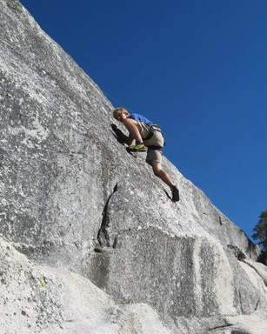
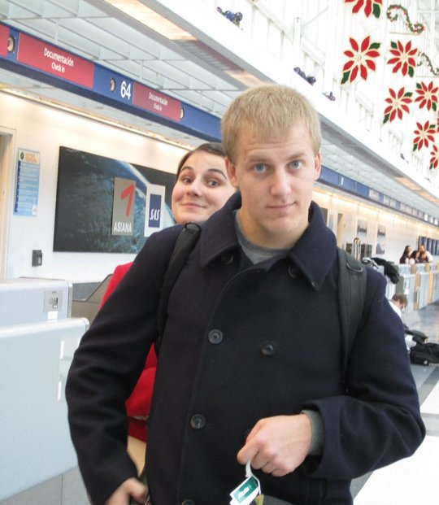
A quick story…
Yosemite, 2009
Rome, 2010

Slide 3
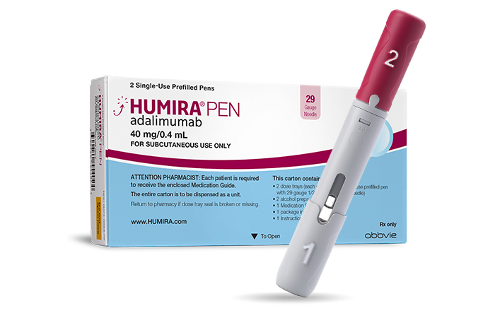
A quick story…
Thanks to Humira, I’m in remission
… but countless people with compromised immune systems either cannot be vaccinated, or aren’t capable of mounting a vaccine-mediated defense
Yosemite, 2009
Rome, 2010

Slide 4
Getting vaccinated protects you
&
the people around you

Slide 5
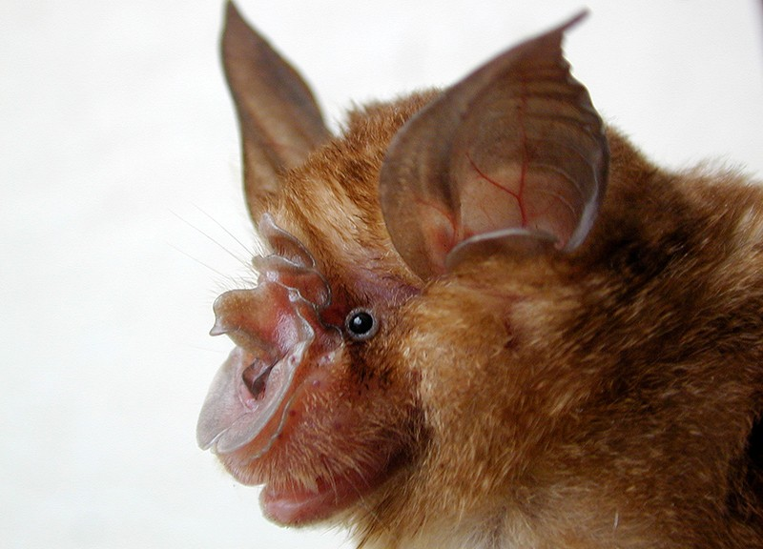
Update from the front lines of SARS-CoV-2 research
Common ancestor of all viruses present in humans existed
mid-Nov – early Dec 2019
Pekar et al., 2021. Science
Zoom webinar on SARS-CoV-2 origins

Slide 6
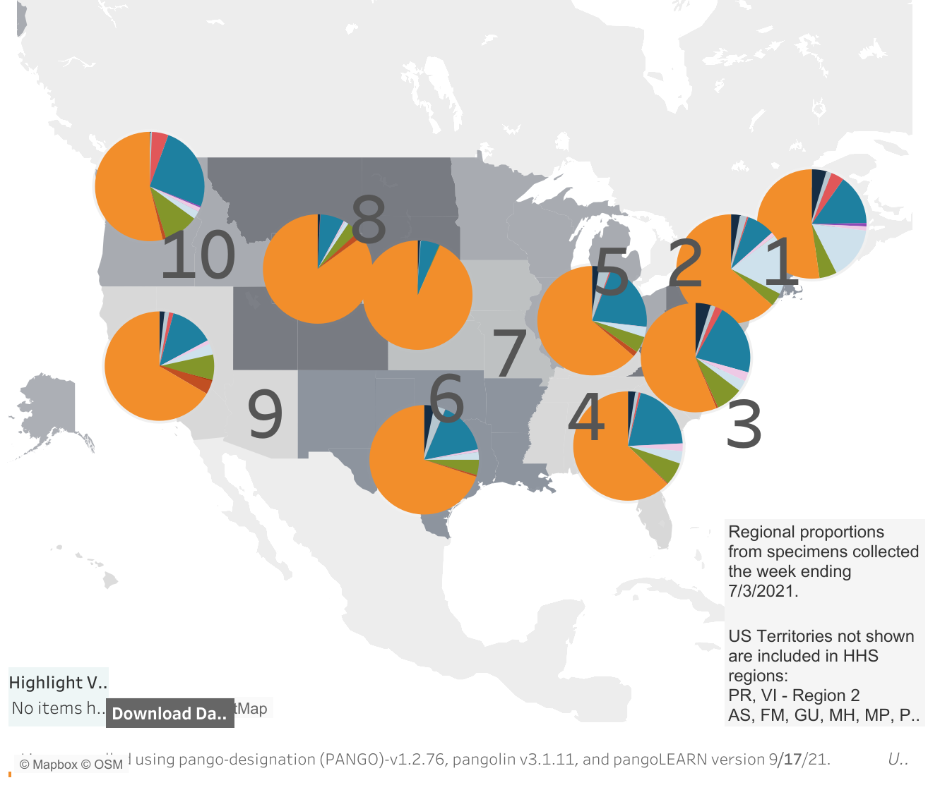
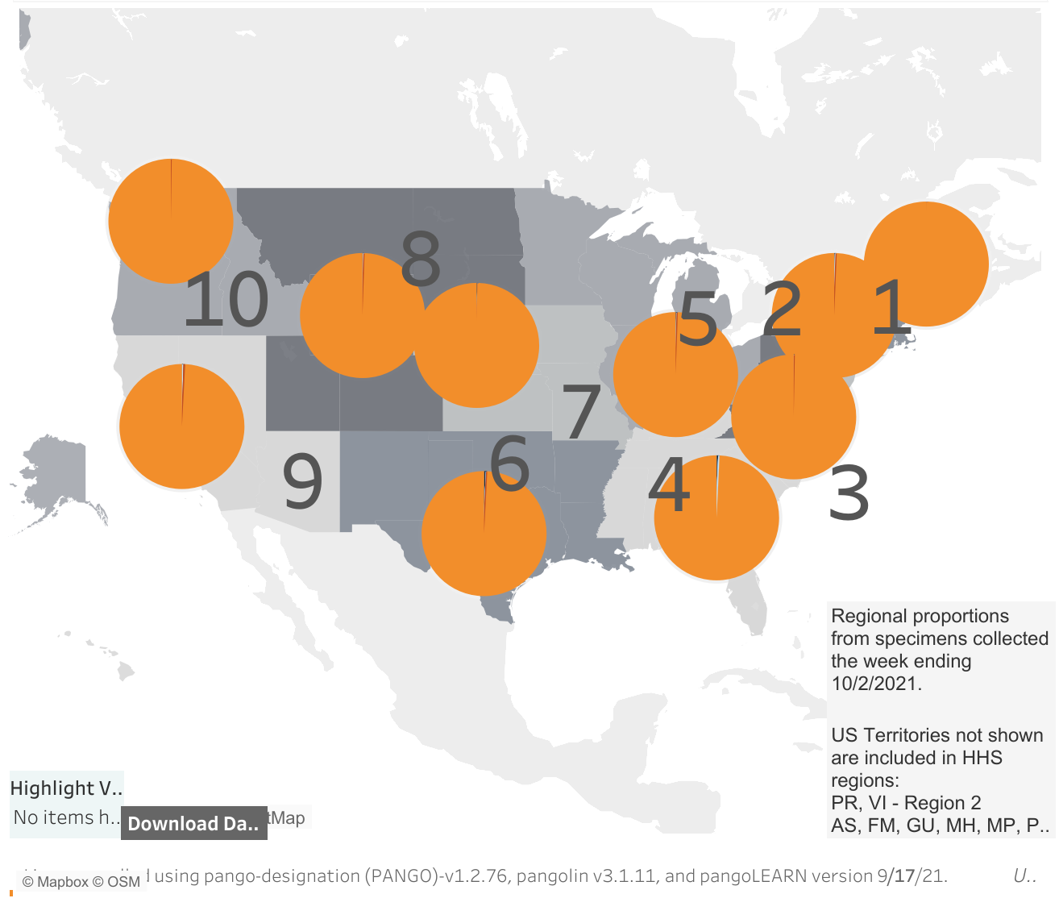
Update from the front lines of SARS-CoV-2 research
CDC
Common ancestor of all viruses present in humans existed
mid-Nov – early Dec 2019
July 2021
September 2021
Pekar et al., 2021. Science
Zoom webinar on SARS-CoV-2 origins

Slide 7
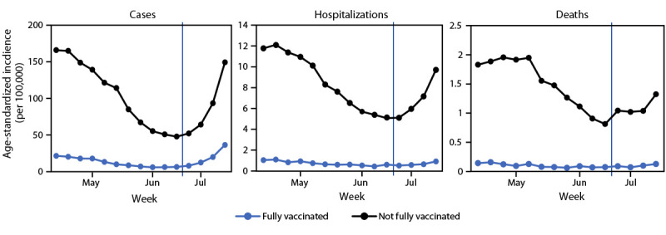
Luckily, vaccines & masks work.
CDC Morbidity and Mortality Weekly Report Report released September 10

Slide 8
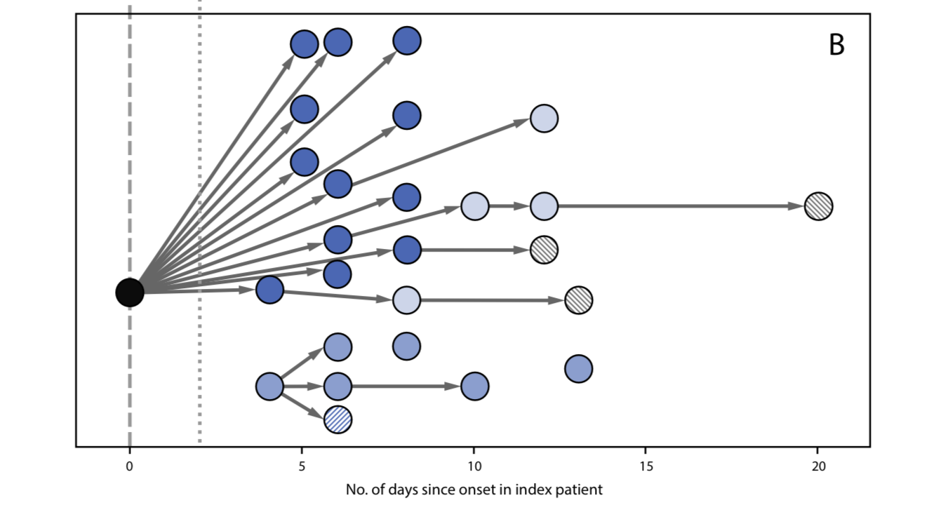
Luckily, vaccines & masks work.
Delta variant spreads unchecked through unvaccinated class by unmasked teacher
CDC Morbidity and Mortality Weekly Report Report released September 3

Slide 9
Luckily, vaccines & masks work.
Delta variant spreads unchecked through unvaccinated class by unmasked teacher
Lack of masks, poor socio-economic status, school size associated with spread in schools
CDC Morbidity and Mortality Weekly Report Report released September 3
Spread in Schools

Slide 10
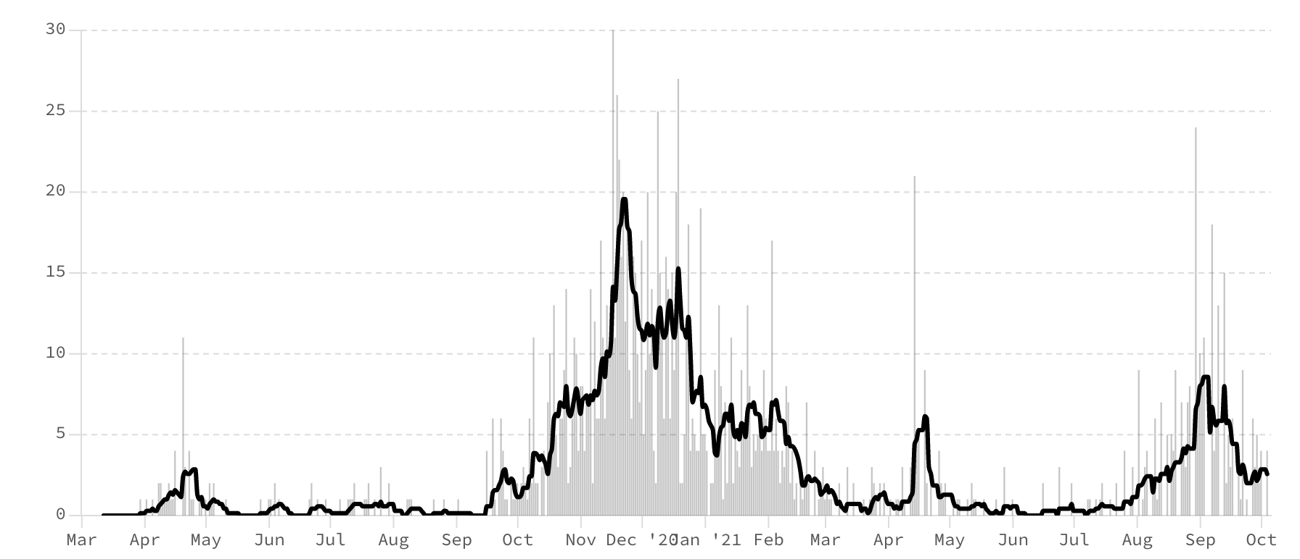
Luckily, vaccines & masks work.
Even in Socorro
𝜶, 𝜷, 𝜸
𝜹
Much smaller peak, despite being
2-3x more transmissible
COVID Case Data

Slide 11
And, vaccines are safe!
Probability of myocarditis or pericarditis higher in COVID-19 cases!
Barda et al., 2021. NEJM

Slide 12
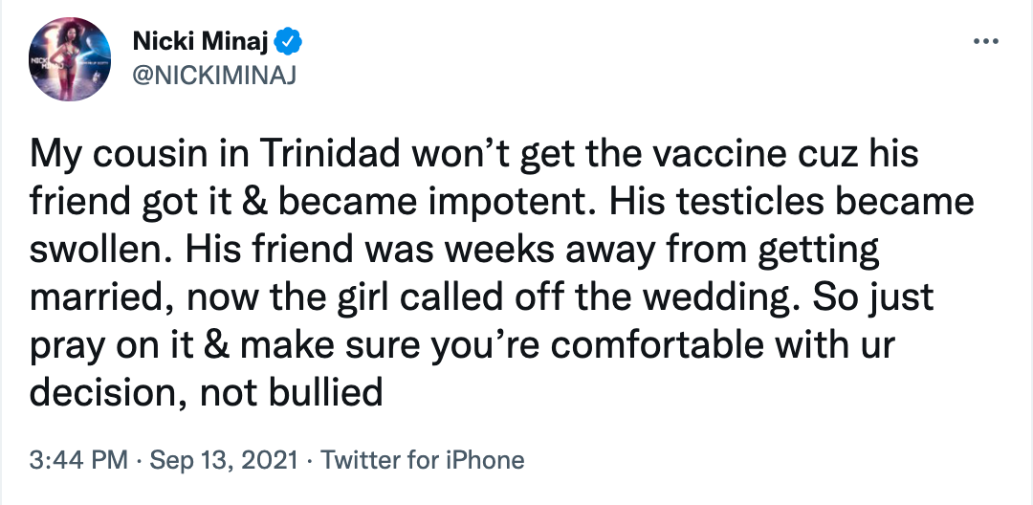
And, vaccines are safe!
Probably actually Gonorrhea…

Slide 13
Why do I care if YOU get vaccinated?

Slide 14
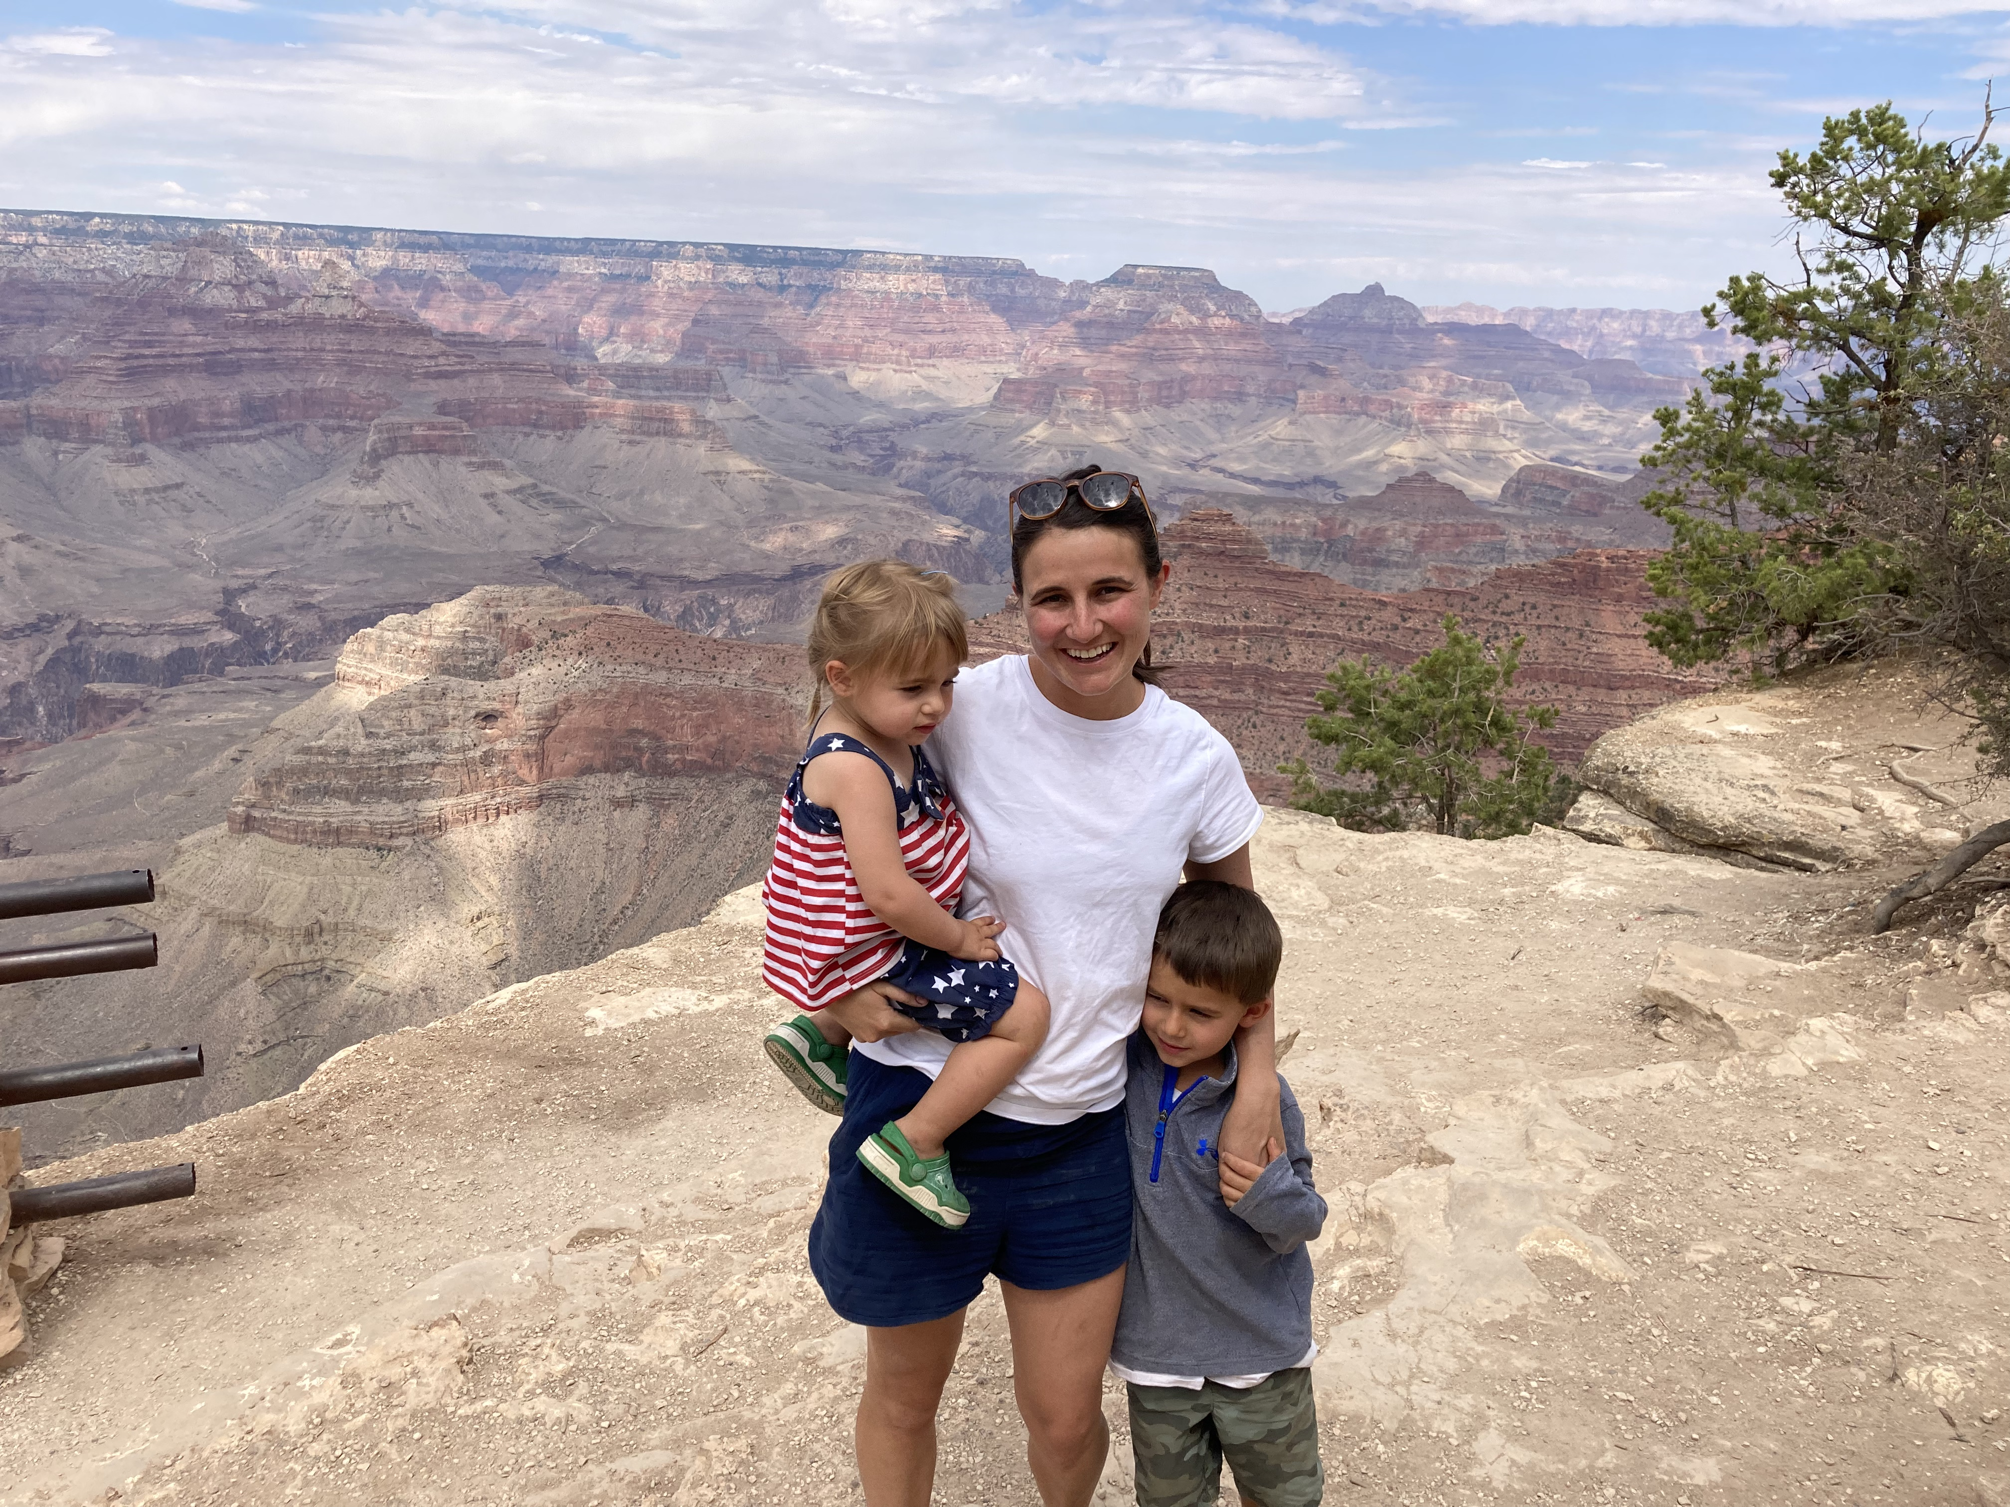

Slide 15
References Barda et al., 2021. NEJM. Safety of the BNT162b2 mRNA Covid-19 Vaccine in a Nationwide Setting. 385: 1078-1090. Pekar et al., 2021. Science. Timing the SARS-CoV-2 index case in Hubei province. 372: 412-417. CDC Variant Tracker. Accessed 10/5/2021. CDC Morbidity and Mortality Weekly Report Report released September 10. CDC Morbidity and Mortality Weekly Report Report released September 3. Jehn et al., 2021 (October 1). CDC MMWR. Association Between K–12 School Mask Policies and School-Associated COVID-19 Outbreaks — Maricopa and Pima Counties, Arizona, July–August 2021.70: 1372-1374. COVID ActNow. Accessed 10/5/2021. COVID Vaccine Information Panel COVID Vaccine Slides

